Slide 1
COMP1003 – Algorithms, Data Structures & Mathematics Graphs
Thomas Wennekers
University of Plymouth

Slide 2
Main Ideas
Arrays and lists hold linearly arranged data
Trees implement hierarchically related data
Graphs describe data where (pairs of) items can be related in an arbitrary way:
→ subway stations; web pages; social relations
Graphs are an ADT. One can insert and delete nodes and edges, traverse and search, and much more

Slide 3
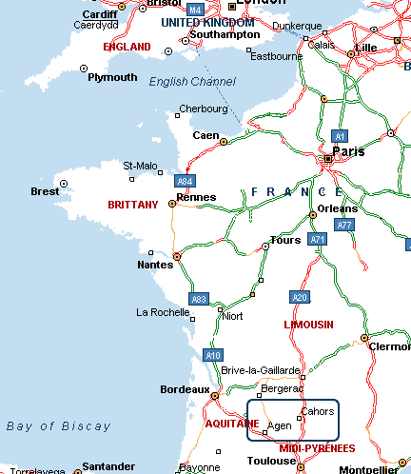
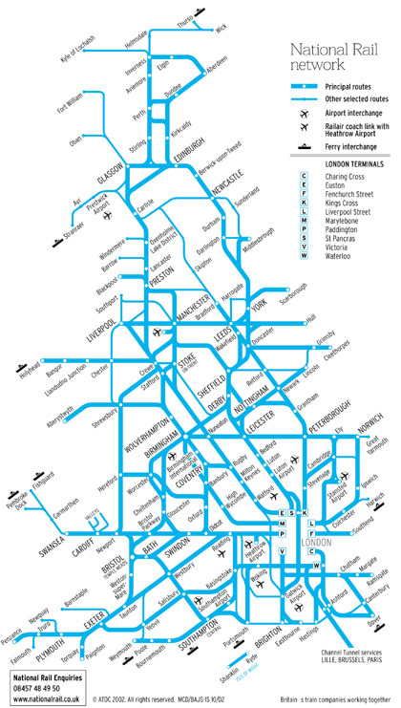
Example 1 – Street&Train Maps
Is there a path from A to B?
Which is the shortest, fastest or cheapest path?

Slide 4
Example 2 – Workflow Optimisation
Project planning identifies a number of tasks required to solve a problem
Different tasks need different time (“man-days”)
Tasks may depend on other tasks; some things have to be done before others
→ Problem: Which is an order of the tasks that allows to finish the project in the shortest time?
→ this requires “topological sorting” of the nodes of the graph describing the task dependences

Slide 5
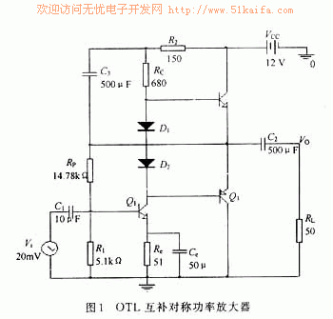
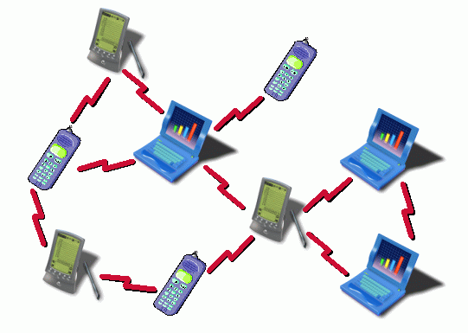
Example 3 – Technical Networks
simulation of electronic circuits
“best” routing of internet and phone packets

Slide 6
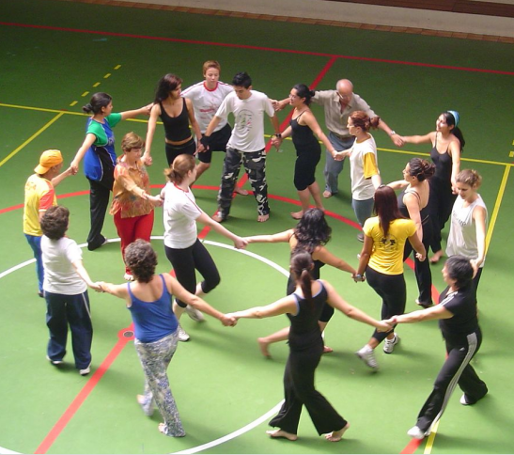
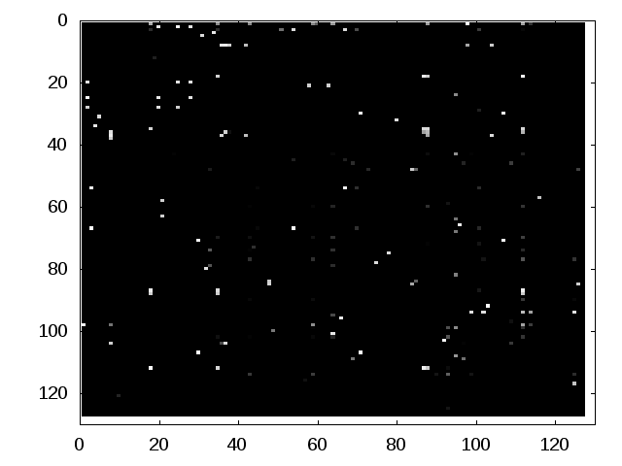
Example 4 – Social Networks
A Code Similarity Matrix for 127 Students; light entries indicate similar code
Left: Who dances with whom?
Right: Who copies from whom?

Slide 7
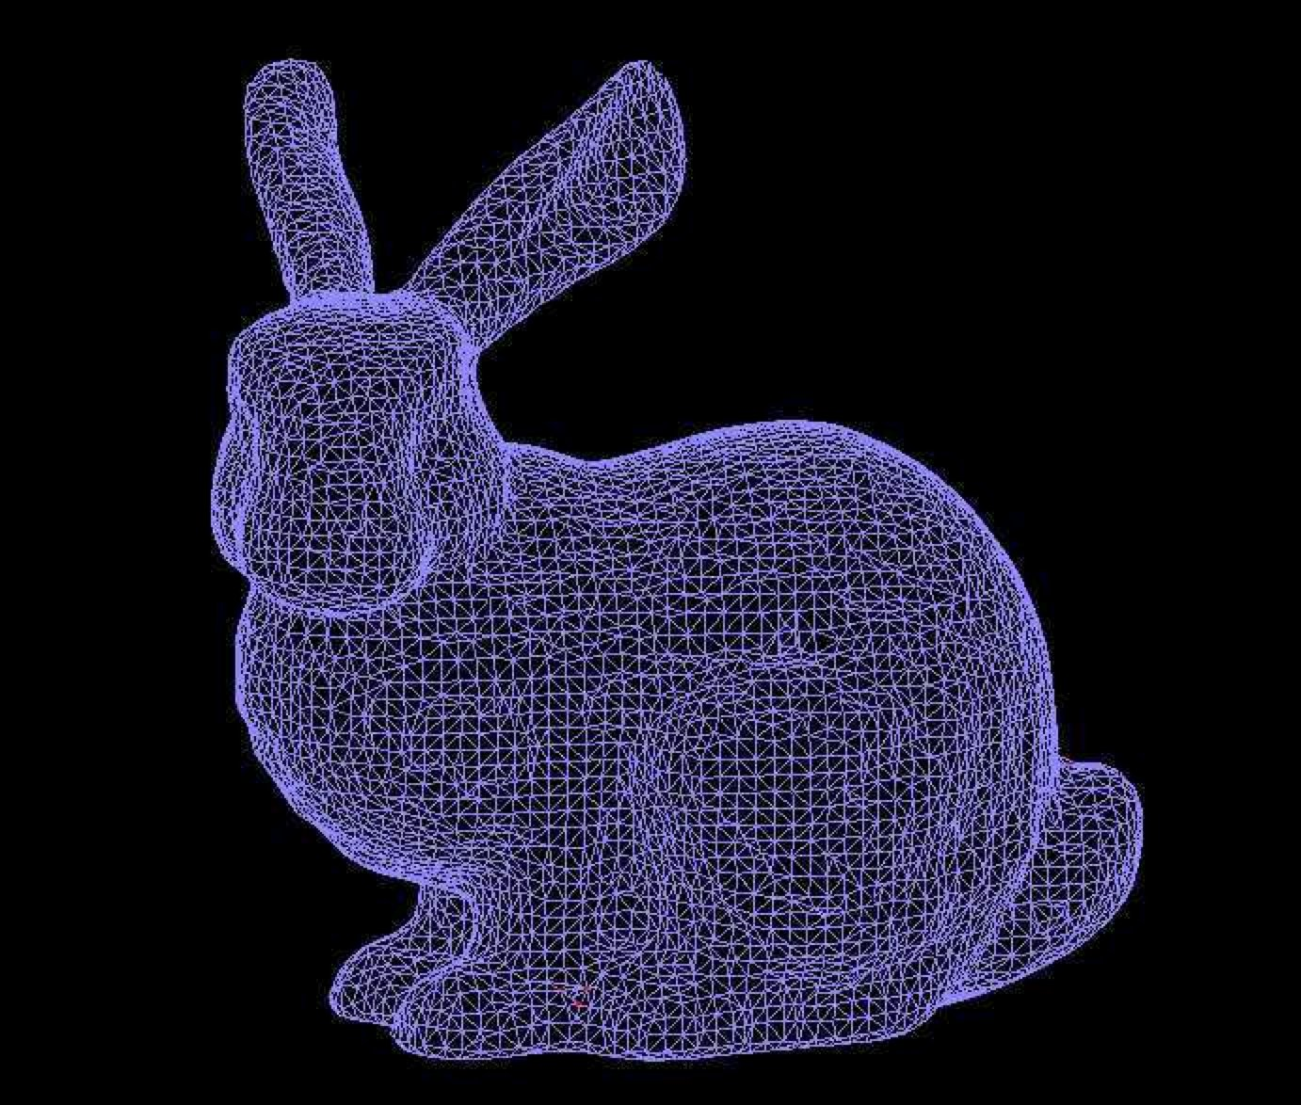
Example 5 Meshes in 3D Graphics
Huge numbers of vertices require efficient algorithms

Slide 8
Aims and Objectives
Understand the relevance of graphs
Learn about representations of graphs
Learn about some algorithms on graphs

Slide 9
Outline
Examples where graphs are important
Graph definitions
Graph representations on computers
Depth-first traversal
Breadth-first traversal

Slide 10
Graph Definitions and Properties

Slide 11
A Directed Graph (Digraph)
Imagine a group of ten students
Each one writes down the names of up to three “best friends”
We can summarise this information using a diagram (with letters for names)

Slide 12
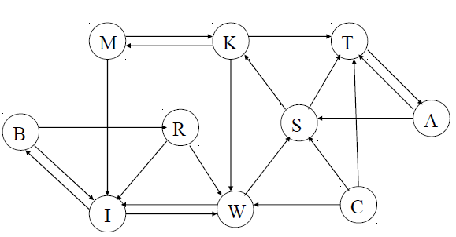
A Directed Graph (Digraph)

Slide 13
Some Graph Definitions
Graphs have a number of Nodes and Edges
Nodes are also called Vertices (singular: Vertex). They contain the data and can be enumerated, 0, 1, 2 ...
Edges are pairs of node indexes, (5,7), (3,3), ...
In “directed graphs” the order of the pairs matter
In “simple” or “undirected graphs” edges are bi-directional; they are not directed or oriented
In labelled graphs, edges have labels, e.g., weights

Slide 14
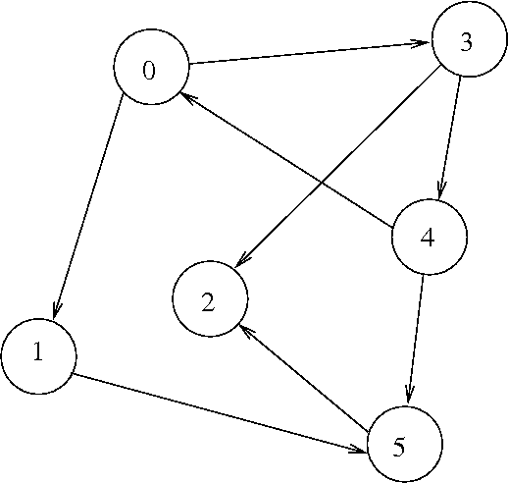
An (Unlabeled) Directed Graph

Slide 15
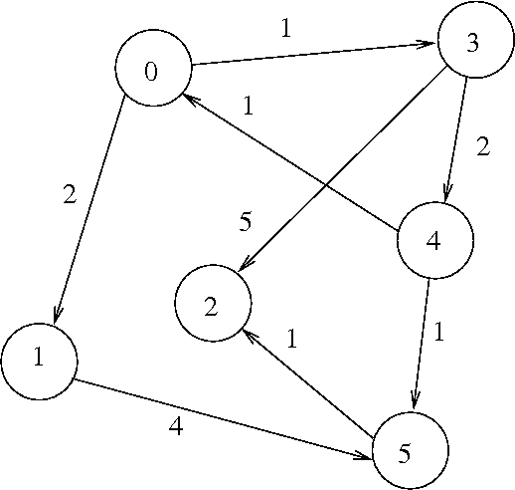
A Labelled Directed Graph
If the labels are numbers one also speaks of a weighted graph (costs, distances)
The labels can also be strings or other data types (names, colours, even graphs again)

Slide 16
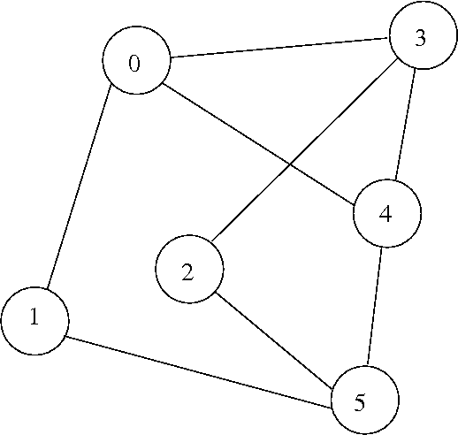
An Undirected (or “Simple”) Graph
Simple Graphs only express which pairs are related.

Slide 17
Graph Representations

Slide 18
Graph Representations on Computers
We will go through the following possibilities
Node and edge arrays
Adjacency matrix
Node array with linked edge lists
Note: there are more ways to represent graphs; different implementations can be useful in different contexts

Slide 19
Node and Edge Arrays
Graph = Nodes + Edges
Nodes can be enumerated, 0, 1, 2, … N-1
Edges are pairs of Node indexes, i.e. (4,5)
Nodes and Edges could just be stored in arrays
Type[ ] nodes = new Type[N]; // “Type” describes the Nodes
int[,] edges = new int[N,2]; // source and destination indexes
This is not flexible in dynamic contexts, where the number of nodes and edges can change → use lists or other dynamic ADT
Edges could also have “labels”, i.e. data attached to them

Slide 20
Adjacency Matrix
This method uses a square array of boolean values
– Each element indicates the presence or absence of an edge
– Alternatively we could hold the associated cost of the edges in the array (as long as there is a distinct value which means “no edge”)
– Node values would have to be stored in a separate array

Slide 21
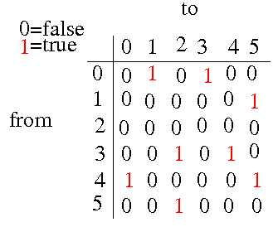
Adjacency Matrix
Note: Directed graphs usually have asymmetric adjacency matrices

Slide 22
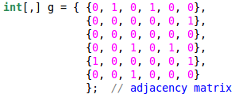
Adjacency Matrix in C#

Slide 23
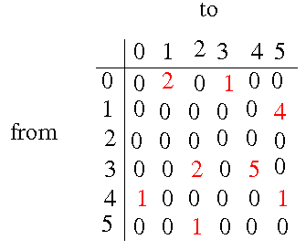
Weight Matrix for Labelled Graphs
Here “0” means “no connection”; but this could also be a valid weight in some applications

Slide 24
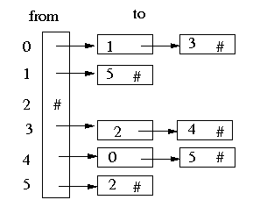
Node Array with Edge Lists
Note: The node-array could contain complex data per item; edges could contain more data as well

Slide 25
Node and Edge Lists
A node array still does not allow for a flexible number of nodes
A list for nodes, each with lists for edges is most flexible
insertNode, deleteNode, insertEdge, deleteEdge etc. can be build on top of list-implementations but deletion can be tricky
Instead of lists (search-)trees can also be used
The nodes and edges can be more complex than integers or pairs of integers

Slide 26
Short Implementation Example:
Graph build on linked lists

Slide 27
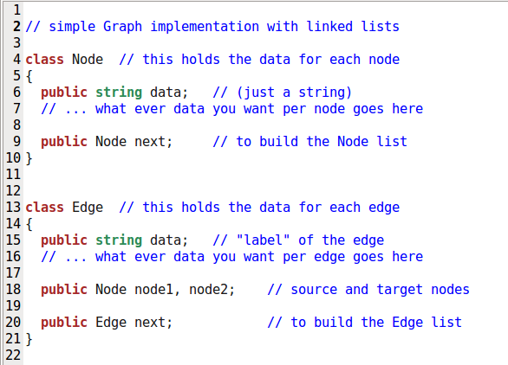
Classes for Nodes and Edges

Slide 28
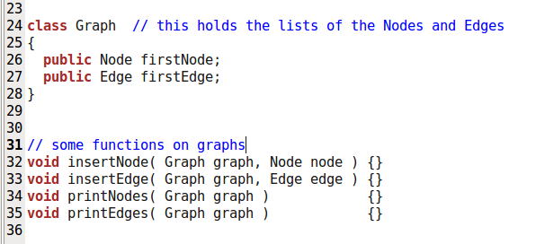
Graph Class and some Functions

Slide 29
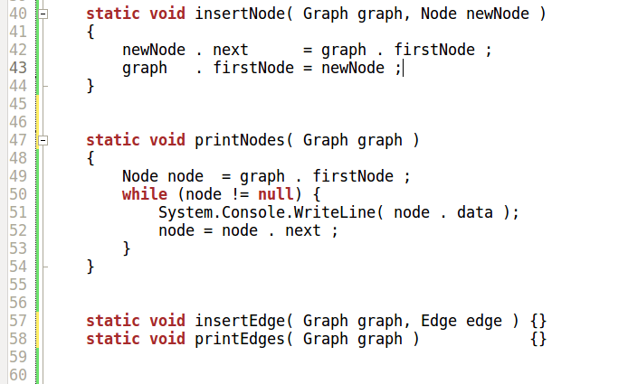
Some code filled in
Note: This is just list insertion and traversal for the Nodes

Slide 30
Graph Traversal

Slide 31
Graph Traversal
Graph Traversal means visiting all nodes in a graph (once) using only the allowed edges.
Usually some operation is done on the nodes, for example printing some of the data.
Other tasks that require following paths through the graph are computing distances between nodes or finding a shortest path.

Slide 32
Graph Traversal
As for Trees (which are a sub-class of graphs) there are two major traversal algorithms:
Depth First: Beginning at one node follow edges as deeply into the graph as possible without visiting nodes twice. Backtrack to the next higher node if that is no longer possible.
Breadth First: Beginning from some node, first visit its children, then all children on the next deeper level, then nodes reachable in 3 steps and not yet visited, and so on.

Slide 33
Labyrinth Analogon
How to find the way out of a Labyrinth, i.e. a house with rooms with many doors?
Depth First: In each room follow one door. Mark each door you take and each room you visit. If you encounter an already visited room, go back to the last room with doors left.
If there is a way to the exit at all you will find it.

Slide 34
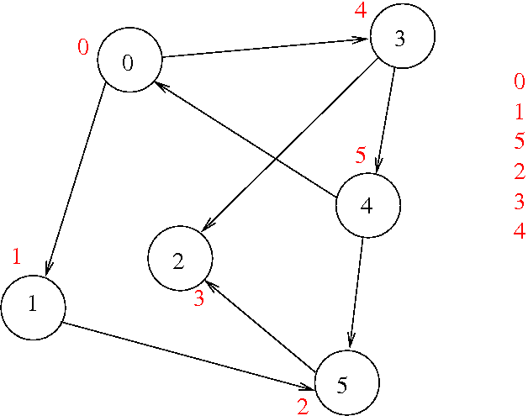
Depth First Graph Traversal
START
This example uses a directed graph – doors can only be opened from one side (but then are open for any backtracking required)
Left: Red numbers indicate the order of traversal
Right: Red numbers indicate order nodes encountered

Slide 35
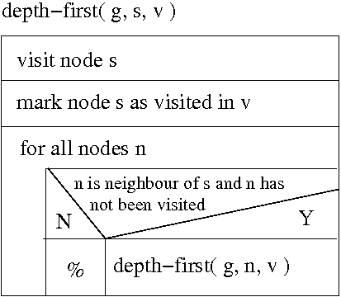
Depth-First Algorithm
g is a graph
s is the start node
v is an array indicating which nodes are still to be visited
“to visit” means to do something with the node
recursive call!

Slide 36
Spanning Tree
If during the depth-first traversal process, we “highlight” each movement along an edge to an unvisited node, we obtain a reduced graph which contains no loops
This is known as a spanning tree for the graph, rooted at the start node of the traversal
“Spanning” here means “visiting every node of the graph”

Slide 37
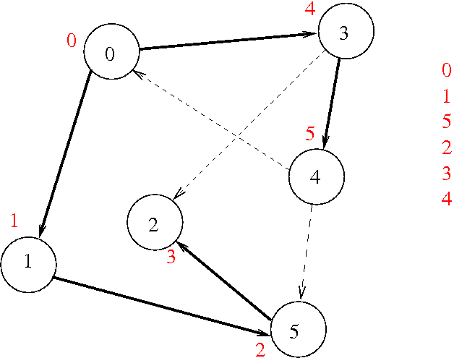
Spanning Tree Example
START
The dashed edges can be removed. The thick edges suffice to traverse the graph.
Can drastically increase traversal in large or dense graphs (e.g., 3D rendering)

Slide 38
Breadth First Algorithm Labyrinth Analogon
Visit the rooms in order of their “level” i.e. the number of doors that have to be opened to reach them from the start node.

Slide 39
Breadth First Algorithm Labyrinth Analogon
Start in a room
When you encounter a new room (including the start room) append the doors in it to a queue indicating that you have not tried them yet
Mark each room you visit as visited
Follow all doors in the order they appear in the queue; but don't go through a room twice (i.e., don't append it's doors to the queue a 2nd time)

Slide 40
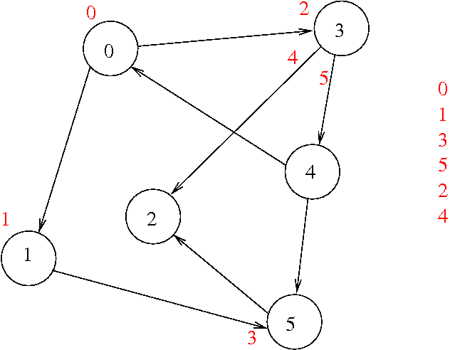
Breadth First Traversal
START

Slide 41
Breadth First Search
The previous algorithm visits the rooms “breadth-first” because
In the start room only doors to rooms at level one are appended to the memory list
All these level one rooms are then visited and their doors appended. These are all doors that lead to level two rooms
All level two rooms are then visited and their (level three) doors appended. And so on.
Note: “Level k” means k doors have to be opened to reach some room from the start room

Slide 42
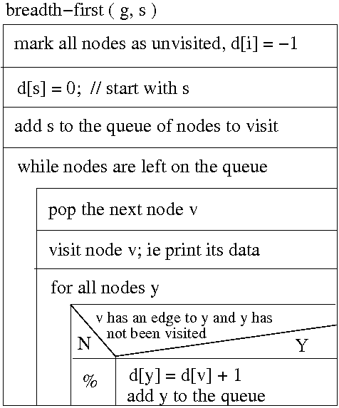
Breadth-First Algorithm
g is a graph
s is the start node
d[] holds the levels of the nodes;
d[k]=-1 means a node has not yet been visited

Slide 43
Breadth-First Algorithm
a linked-list representation of the graph can speed this up relative to an adjacency matrix especially if the graph is large and sparse

Slide 44
Breadth-First Algorithm
the array “d” returns distances between “s” and the other nodes in terms of edges to follow; these are not necessarily the shortest distances

Slide 45
Outcomes
Graphs are an abstract data type ...
… with examples of applications in many areas
Various possible representations on computers
with pros and cons regarding complexity
Graph Traversal algorithms: Depth-first and Breadth-first traversal

